Slide 1
PROBLEM STATEMENT
INTEGRATED COMMON SERVICES TO PEOPLE
Enhancing Educational Access and Efficiency
In today's digital age, accessing comprehensive educational services remains a challenge due to fragmented information and complex processes. Key issues include:
Access to Educational Services: Locating relevant educational resources, institutions, and learning materials efficiently.
Recruitment and Admission Processes: Streamlining teacher and student recruitment/admission processes for institutions and centers.
Educational Support Services: Providing easy access to tutoring, vocational training, and cultural activities.

Slide 2
UNIQUE IDEA
Integrated Educational Services Platform,Our project aims to develop a sophisticated web application using the MERN stack architecture.
This platform will serve as a unified hub for educational services, designed to enhance accessibility and streamline various educational processes.
The goal is to bridge the gap between students, parents, educators, and institutions by providing a comprehensive solution that addresses their needs efficiently.

Slide 3
FEATURES OFFERED
User-Centric Services:
Learning Resources: Access to online materials, educational videos, and e-books.
Educational Institutions: Details on schools and colleges, including admissions, fee structures, and facilities.
Second-hand Learning Materials: Listings for affordable textbooks, educational gadgets, and resources.
Tuition Centers: Locating nearby tuition centers with subject-specific tutoring and teacher profiles.
Cultural and Vocational Activities: Information on arts, music, sports, and vocational training centers.
Industry Training and Job Centers: Access to vocational training and job placement services.
Institution and Center Functionality:
Post Vacancies: Institutions and centers can post vacancies for teachers and administrative staff after registration and approval.
Admissions Management: Manage student admissions with online application forms and enrollment processes.

Slide 4
PROCESS WORK FLOW
User Registration and Authentication:
Users (students, parents, educators) register and authenticate securely to access tailored services.
Institution and Center Registration:
Institutions and centers register on the platform and submit required documentation for verification.
Admin reviews and approves the registration requests. Upon approval, institutions and centers are added to the database.
Search and Discovery:
Seamless search functionality based on location, educational needs, and user preferences.
Recruitment and Admission Management:
Institutions and centers post vacancies for teachers and administrative roles after admin approval.
Manage student admissions through centralized application processing and enrollment management.

Slide 5
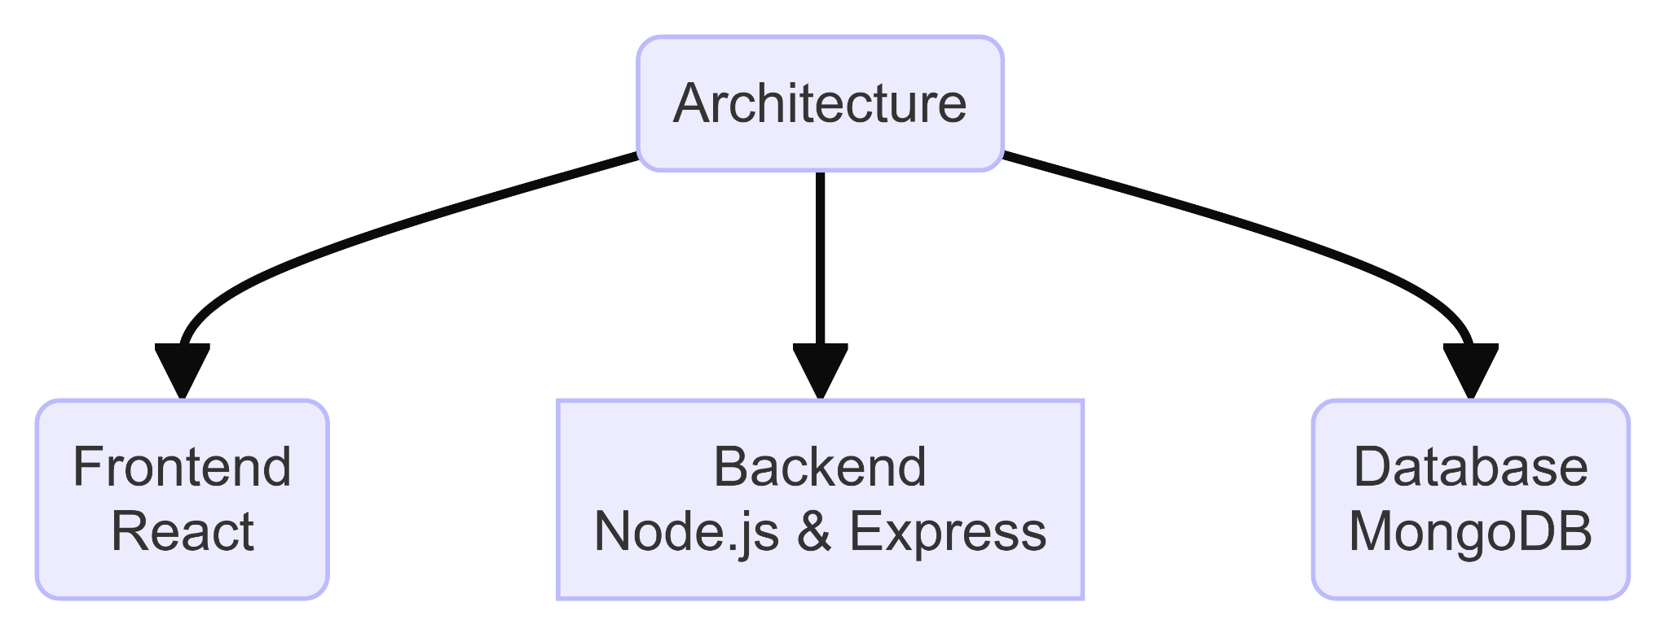
ARCHITECTURE DIAGRAM

Slide 6
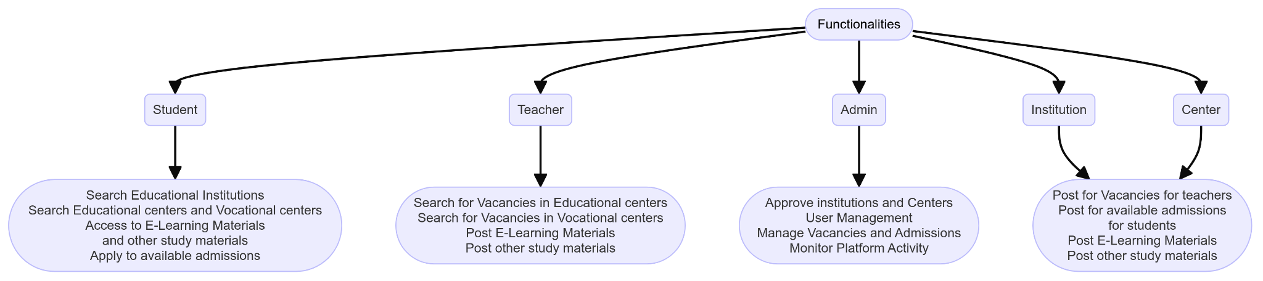
ARCHITECTURE DIAGRAM

Slide 7
TECHNOLOGIES USED
Frontend:
React (JavaScript library for building user interfaces)
Backend:
Node.js (JavaScript runtime environment)
Express.js (web application framework for Node.js)
Database:
MongoDB (NoSQL database)
File Uploads:
Multer (middleware for handling multipart/form-data, used for file uploads)
Cloud Storage:
Cloudinary (cloud-based image and video management services)

Slide 8
TEAM MEMBERS AND CONTRIBUTION:
VAANMUGILAN T: Created the UI/UX design for the application, ensuring intuitive navigation and user-friendly interactions.
RASHMIKA K R: Implemented backend functionalities and API development using Node.js and Express.js.
NISHDHARANI P: Designed and developed the frontend user interface using React.js, focusing on usability and responsive design.

Slide 9
CONCLUSION
Our application will empower individuals by providing easy access to educational resources and services. Leveraging the MERN stack ensures scalability, performance, and flexibility, enabling institutions and centers to efficiently manage student and teacher vacancies. By bridging the gap in educational accessibility, we aim to support lifelong learning and educational equity for all.

